Slide 1
Why Do We Need Routing?
Defining the Routing Problem
Why Do We Need Routing?
Modeling the Network
What Makes Routing Hard?
Types of Routing Protocols
Routing States
Destination-Based Forwarding
Least-Cost Routing
Static Routing
Lecture 4, Spring 2026
Notes:
so this is the outline of what we'll talk about today we're first going to actually drop down some formal
20:30
definitions so we should really Define this problem so that we know what we're trying to solve exactly we'll talk about
20:36
why this is a hard problem and the different types of solutions we can apply to it and then we'll talk a little
20:41
bit about what the solution space looks like so what is it actually mean to come up with an answer what even does the
20:47
answer itself look like and what makes an answer good what makes an answer bad so today is mostly about definitions and
20:53
setting up the problem and then starting next time we're really going to dive into ways to actually solve this problem
21:00
but today is just an overview of all the definitions and making the problem more
21:07
concrete

Slide 2
Today's Goal: Routing
Today's goal is routing: Finding paths through the network.
We'll first formally define the problem.
Why is it needed?
Why is it a hard problem?
What types of algorithms exist?
Then, we'll see how to assess a solution.
What does a solution look like?
What makes a solution valid?
What makes a solution good?
R1
R4
D
A
R2
R3
R7
B
R5
R8
C
R6
Notes:
okay so here we go the goal is routing and we've sort of already hinted at this problem before but basically if
21:14
a router receives a packet it needs to know should I send it this way should I send it this way that's the question
21:19
we're going to spend a lot of time answering so we're going to define the problem we're going to say why do you need routing in the first place what
21:26
would the internet without routing look like why is it hard what are the algorithms and how do we classify the
21:32
different types of algorithms and then we'll look at how do you measure the quality of a solution what even does a
21:38
solution look like in the first place how do you know if the solution works and how do you know if the solution is
21:44
good so it's a lot of definitions

Slide 3
Why Do We Need Routing? – Full Mesh Topology
If 2 machines want to communicate, we can add a link between them.
What if we had 5 machines?
We could add a link between every pair of machines.
The result is called a full-mesh topology.
Problem: This doesn't scale well. Imagine adding a new machine.
Has benefits in limited settings.
Good if we need dedicated high bandwidth between every pair of machines.
C
A
B
D
E
Notes:
why we need routing we can first imagine a world without routing who needs routing who needs these six lectures
21:57
what if we just go without it so to rewind a little bit remember we said if two machines want to communicate
22:04
just stick a link between them and now they can talk to each other that's great if I have two machines what if I have
22:10
five machines well maybe something I could do is I could just add a link between every pair of machines so we're
22:18
going at this without routers no one needs routers we'll just install a bunch of links between every pair of machines
22:24
and now if anyone wants to talk to each other they can just send the packet along the L link to the recipient so if
22:30
D wants to talk to C okay that's no problem D will just send a packet along this link and it reaches C see no
22:37
routing required we don't need these lectures if you build something like this it's called the full mesh topology
22:43
and if you have something like five hosts this might be okay but we can already see if you try to do this with
22:50
10 hosts or 100 hosts or the billions of hosts that are in the real internet this
22:55
is not going to scale so I mean even imagine adding a sixth machine to this picture when you add the sixth machine
23:02
you would have to go and install new links from machine F to all five of these machines so every time I add a new
23:09
machine I have to add a whole bunch of links that's pretty annoying so this topology while it helps us avoid routing
23:17
it would create enormous scaling problems and we would never reach the internet scale that said there are some
23:24
places where you actually want something like this so in some settings maybe you do want a mesh topology which is what we
23:30
call it when everyone is connected to everyone else maybe you want this because now DNC have a dedicated link so
23:37
remember last time we talked about resource sharing well if you have a mesh topology you don't have to share this
23:42
resource with anyone else DNC are the only people using this link no one else is using it if that is a desirable
23:49
property to you maybe this is the topology you want to go with it's not going to scale very well it's going to
23:54
be very expensive if you want to build this for a lot of machines but if dedicated bandwidth is something you
24:00
really care about maybe this is the way to go so once again we're seeing the network has a lot a lot of trade-offs
24:07
and here you'd be trading off scalability for really good dedicated performance but if we want internet
24:14
scale we can't have this so we need to go finding something else

Slide 4
Why Do We Need Routing? – Single-Link Topology
Another approach: Use a single link (wire) to connect all 5 machines.
Scales better than the full-mesh topology.
Problem: Less bandwidth available. Everyone has to share the link.
A
B
C
D
E
Notes:
the other direction instead of using a whole bunch of links to connect everyone what if we just use the single link so
24:27
this is just the single wire and I'm just hooking it up to all five machines so it's one wire five machines well
24:34
that's great because now if anyone else comes along we just have to extend that wire and plug it into them so it's not
24:40
like I have to connect host F to everyone else we just take this wire and plug that same wire into F that's pretty
24:47
good so this has better scaling properties but there's the problem here and the problem is we no longer have a
24:54
lot of bandwidth in fact everyone has to share the same link for example if a is talking to d e cannot be using the link
25:02
because A and D are using it right now or if B and C are talking well then e can't use the link this is a single link
25:10
so if anyone's talking other people can't use it everyone has to share so even this has scaling problems if you
25:16
try to scale this up to the whole internet well then no one's going to be able to talk because only one person can
25:22
talk at any time so we've seen both extremes the extreme of connecting
25:27
everyone with a dedicated link has scaling issues and the solution where we
25:32
use a single link for everyone has bandwidth issues so neither of these are really good and that's what brings us to
25:39
routing as a solution we want more sophisticated topologies

Slide 5
Why Do We Need Routing? – Introducing Routers
To use more sophisticated topologies, we need to introduce a router.
Router: An intermediate machine that can forward data.
If we use routers to connect the machines:
We use fewer links than the full-mesh topology.
We have more capacity than just a single link.
A
B
R1
C
D
R2
R3
E
Notes:
and here we have not a case where everyone is directly connected like the
25:50
full mesh but we also don't have a case where everyone's sharing one wire like the single wire approach from earlier
25:57
but to build topologies that look like this we now need routers and that's something we've already seen these
26:03
machines sit on the internet and their goal is just to forward data closer to their destination so this gives us the
26:10
best of both worlds we don't need as many links as full mesh so we can scale this more but we also have a lot of
26:16
capacity so for example if a link goes down we can switch to other ones there's
26:21
more capacity than if there was just a single Link in the network and so as mentioned earlier if a

Slide 6
Why Do We Need Routing? – Introducing Routers
Another benefit: If a link goes down, traffic could use another path.
We now need some way to compute paths through the network: Routing protocols!
A
A
B
R1
C
B
R1
C
D
R2
R3
E
D
R2
R3
E
Link goes down!
Notes:
26:29
link goes down packets can even take a different path through the network and that's something else that's pretty nice
26:34
that we'll try to exploit when we design routing protocols sometimes it's the case that a link goes down and the
26:41
26:41
packet can just take a different path that's kind of nice but if you want to use routing if you want to unlock
26:47
solutions that look like this where you can build apologies of your own favorite shapes and connect everyone up in any
26:53
way that you want then we need to answer the routing protocol we need to figure out how exactly did D R2 R3 and E know
27:02
that this is the path to take or that this is the path to take that's the question we have to formally answer so
27:09
that's what we'll Define today

Slide 7
Modeling the Network
Defining the Routing Problem
Why Do We Need Routing?
Modeling the Network
What Makes Routing Hard?
Types of Routing Protocols
Routing States
Destination-Based Forwarding
Least-Cost Routing
Static Routing
Lecture 4, CS 168, Spring 2026
Notes:
okay so now we're going to define a model for what the network looks like so
28:05
that we can actually formally Define the routing problem so for our model which

Slide 8
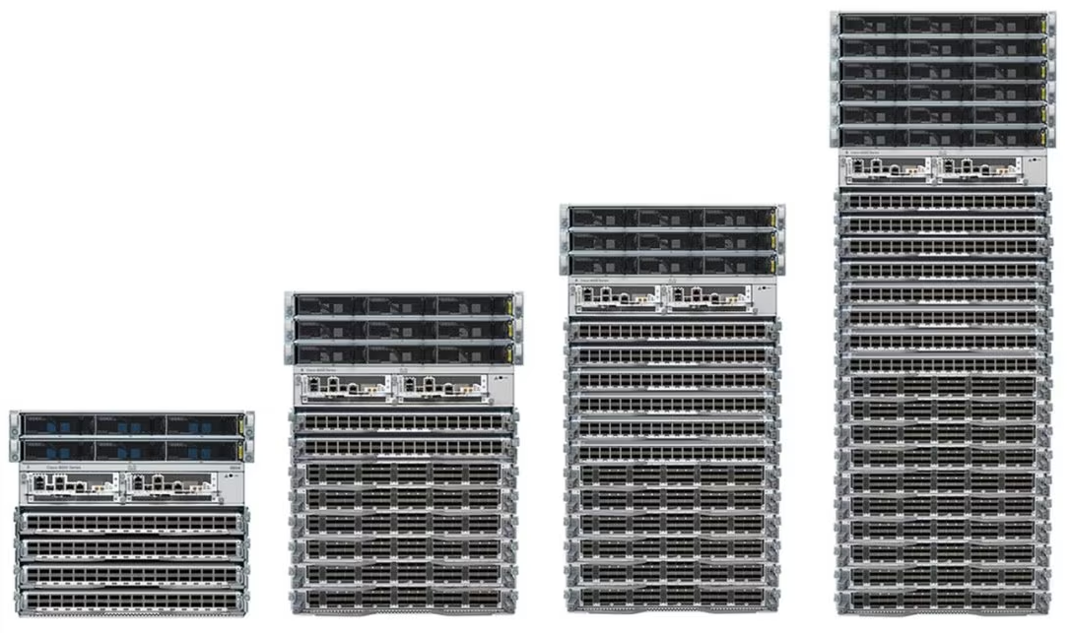
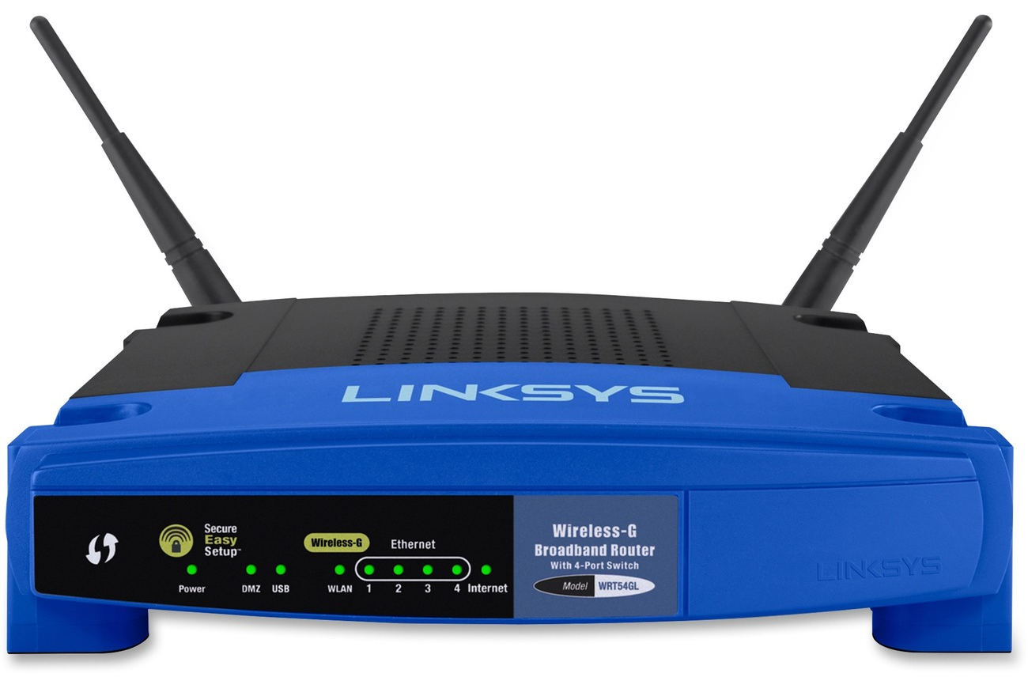
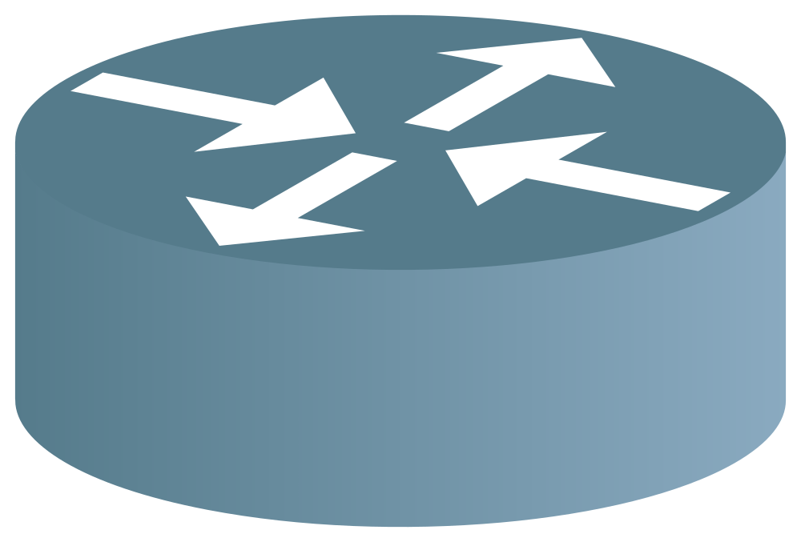
Modeling the Network – Routers vs. Hosts
We'll assume every machine on the network is one of two types.
End hosts send and receive packets, to and from other end hosts.
Example: Your personal computer.
End hosts don't forward intermediate packets.
Routers forward intermediate packets.
Example: Your home router, heavy-duty router in a datacenter.
For now, assume routers don't send and receive packets of their own.
Industrial-sized routers.
Home router.
Router symbol in diagrams.
Notes:
admittedly is a little bit of a simplification real life internet does not look the way we are going to build
28:17
it and along the way I'll point out some of the simplifications we're making but just so that we all have a good
28:23
definition of the problem we're trying to solve we're going to make a couple of simplifications just to make our lives a
28:28
little bit easier so we are going to assume that every machine on the network can be classified into these two types
28:35
in reality maybe not 100% true but for now we'll assume everything is either an
28:40
end host or a router it's one or the other everyone is exactly one of these two types we will also assume end hosts
28:48
only send and receive packets they don't forward packets so for example my
28:53
personal computer is an end host it creates brand new packets to send and it is the final destination of some
29:00
packets for example if Google Slides is sending me this picture of a router it's sending it to my computer as its final
29:08
destination so my computer is sending and receiving packets however my computer is not forwarding packets for
29:14
other people so it's not the case that I receive a packet and I forward it to someone else the only packets that come
29:20
to me are packets for which I am the Final Destination that's a bit of a simplification but it's what we're going
29:26
with today the other type of machine on the Internet is a router and for now we
29:32
will assume that the routers only have one job and that is to forward packets for other people so routers we're going
29:38
to assume they don't create their own packets we're going to assume they're not the Final Destination I don't ever
29:44
want to talk to a router I want to talk to other end hosts and routers their only job is to receive a packet and
29:50
forward it toward its destination kind of a simplification but for our model good enough and in case you're wondering
29:56
what routers look like in real life if you go into a data center you see these really big people sized routers in your
30:02
home you might have a tiny one like this and in a diagram sometimes people draw this symbol which is apparently a
30:08
universally accepted symbol for router although in our class we tend to draw
30:13
squares so for now we'll assume everything is one of these two types later in the class we'll maybe somewhat
30:19
relax these assumptions but they are assumptions they'll just give us a model

Slide 9
Modeling the Network – Graph
We'll draw the network as a graph.
Each edge represents a link. For now, assume a link connects exactly 2 machines.
For now, assume each machine is identified by a unique label.
We'll think more about addressing later.
R1
R4
D
A
= End host
= Router
A
R2
R3
R1
R7
B
R5
R8
C
R6
Notes:
with something else that we'll assume is that our Network looks like a graph and it looks like one of these graphs so for
30:31
now we'll assume that each link connects exactly to machines so for example this link here it connects a and R2 so we're
30:38
not going to draw any of those links that connect three or more computers those do exist you actually saw one
30:44
earlier but for this model that we're currently building we just won't think about this we'll come back to those
30:49
later so the network is a graph each link connects two and only two machines
30:55
no more no less and every machine gets some sort of label and here we'll just
31:00
be lazy with our labels and we'll say they're either letters like a b c or
31:05
router numbers like R1 R2 R3 and later we'll come back and think how do you
31:11
actually give these things meaningful addresses it's not really R3 what is it actually called that's something we'll
31:17
come back to later as well but for now just treat the network as a graph it looks like this it's got end hosts it's
31:24
got routers links connect two machines and everyone has a unique unque label that no one else
31:30
has so that's our model just to make things a little bit easier as we first
31:35
dive into routing

Slide 10
Modeling the Network – Packets
Packets are the basic unit of data sent across the network.
Packets have a header with metadata.
For now, we only care about the source address and destination address fields.
Packets have a payload with the application data.
Example: Website contents, image, etc.
Routing isn't concerned about the payload. It's just a blackbox sequence of 1s and 0s to forward.
Source Address
Destination Address
Payload
Notes:
okay a little bit more modeling
31:40
so we've already talked about what packets are they're the basic unit of data that you send and receive and we've
31:46
talked about packets having headers we've talked about packets wrapping and unwrapping multiple headers for now
31:52
we're going to just focus on layer three which means we really just care about the source address and the final
31:59
destination address so if you think back to all the layers of the internet at layer three we would write something
32:04
like Alice's street address and Bob's street address those are the only two
32:10
header fields that we care about for now in reality yes other fields exist at higher layers at lower layers even
32:17
within this layer but for now we will just think about two header fields to make our lives a little bit easier and
32:23
likewise we don't care about the payload because doesn't really matter if we sending an image or the contents of a
32:30
website or the text on this slide whatever you're sending the router is going to forward it using the header
32:37
fields and it's not going to open up this payload and say I'm going to forward a picture differently we don't do that so whatever's in here it's a
32:44
bunch of ones and zeros and we don't care what it is it's a picture it's a video doesn't matter we're going to
32:49
forward it all the same so it's a little bit of a simplification but it's what we'll be doing for this particular
32:56
unit and remember if you come back for the end to- endend lectures everything will get tied up together just not
33:05
now any thoughts on the
33:11
model

Slide 11
What Makes Routing Hard?
Defining the Routing Problem
Why Do We Need Routing?
Modeling the Network
What Makes Routing Hard?
Types of Routing Protocols
Routing States
Destination-Based Forwarding
Least-Cost Routing
Static Routing
Lecture 4, CS 168, Spring 2026
Notes:
okay so now that we've defined the model for the problem we're trying to solve we talked about the network being
33:17
a graph and all the routers having unique labels we can now start thinking why is this a hard problem why is this
33:24
going to take us a bunch of lectures to solve
because it seems like all I have to do is find the paths and I'm good but it
33:31
turns out there are three challenges that make this a pretty hard problem

Slide 12
What Makes Routing Hard? (1/3) – Changing Topologies
The network graph is constantly changing.
Hosts join and leave the network.
Links can fail, and new links can be added.
Our routing protocol needs to be robust to changes.
A
A
B
R1
C
B
R1
C
D
R2
R3
E
D
R2
R3
E
Link goes down!
Notes:
so one problem right away is that the network never stays the same so it's
33:47
not like someone is handing you a problem and you can take your time solving it and then present me with the
33:52
solution and the solution is correct the network graph is constantly changing which also means that the correct answer
33:59
to routing whatever that means is also changing an answer that's correct today
34:04
could be incorrect tomorrow or even a couple seconds from now and the reason for this is because the topology itself
34:12
never stays the same so new people can connect to the network for example when I walked into the lecture hall today and
34:19
plugged in my computer this was a brand new computer that joined the network so the network changed and so the answer to
34:25
the routing problem also changed and we've also talked about how links can fail or new links can be installed so if
34:32
a link fails or if we add a new link or if we upgrade a link well that's also going to change the network and that
34:38
could also change the answer so whatever protocols we design they have to be robust to the fact that the network is
34:45
constantly changing we don't just hand you one picture of the network and ask for an answer it's always changing all
34:52
the time and we always want to be up to date and have the latest answer

Slide 13
What Makes Routing Hard? (2/3) – Distributed Protocols
Routers don't have a global, birds-eye view of the network.
If a link fails, routers don't automatically know about it.
Routing protocols have to be distributed.
There's no central mastermind computing the answer.
Each router computes its own part of the answer.
Routers must coordinate with each other in the protocol.
R1
R4
D
R2 can't see the whole network.
R2 might only be able to know about its direct neighbors.
A
R2
R3
R7
B
R5
R8
C
R6
Notes:
a second challenge is this protocol is distributed and what that means is there
35:03
is no Central Mastermind that can look at the entire graph and think about the answer so it's not the case that well
35:10
you and I can look at the slide and say okay we see that there are eight routers and four hosts in total on this network
35:17
you and I know that but the network doesn't know that for example if your router R2 it might be the case that you
35:24
have no idea what's going on all the way out here all that you know about is well I'm neighbors with a and R1 and R3 maybe
35:32
that's all you know and you don't know anything else and so turns out routing Protocols are distributed each router
35:39
only knows a little bit about the network usually things about where they are and their direct neighbors and what
35:45
this means is that everyone has to talk to each other to try and get a more complete picture about what's going on
35:52
so there is no one Central Mastermind living above the entire network that can give you the answer every one knows a
35:58
little piece of the answer and they have to coordinate with themselves to try and form something that answers this
36:04
question overall so there going to be a lot of coordination the routers have to talk to each other a lot for example R2
36:10
and R3 have to talk to each other and share some information R3 and R seven might have to talk to each other later
36:16
and share some information and another consequence of the distributed protocol is that no one router is going to have
36:23
the whole answer so it's not going to be the case that R2 by itself can tell you about the entire graph and all of its
36:30
truths usually each router has a little piece of the answer that they need to answer the question and when you
36:36
aggregate every router's information you would get the full solution but in reality each router Only Knows its
36:42
little piece of the solution and that's all that it really needs to operate so that's another challenge the
36:49
protocol is distributed you don't know about what's going on out here if a link fails or someone signs off you don't
36:55
know but you'd have to talk with your neighbors to really be sure about what's going
37:02
on

Slide 14
What Makes Routing Hard? (3/3) – Best-Effort
At Layer 3, links are best-effort. Packets could get dropped.
In summary, challenges of routing:
Topology changes over time.
Routers don't have a global view of the network.
Links are best-effort.
Notes:
the third challenge that we have to solve is best effort so remember we said at layer three everything is best
37:09
effort so all sorts of packets could get dropped when I'm forwarding data a packet could get dropped maybe the
37:15
router has a bug or is over loaded also when the routers talk to each other like
37:20
if R2 and R3 are communicating those packets could get dropped too so we have to be really careful about things being
37:27
best effort we can never say something like well the packet's going to get there and everything is going to be okay
37:34
we always have to worry about packets being best efforted and being dropped so in summary we've identified three things
37:41
that make routing hard the topology is constantly changing it's a distributed problem because no one has a global view
37:48
of the network and everyone Only Knows part of the answer and the links are best effort and things can get dropped
37:54
so as we solve these problems we're going to encounter these challenges over and over again and we will find our ways
38:01
around them but that's something we have to deal
38:09
with

Slide 15
Types of Routing Protocols
Defining the Routing Problem
Why Do We Need Routing?
Modeling the Network
What Makes Routing Hard?
Types of Routing Protocols
Routing States
Destination-Based Forwarding
Least-Cost Routing
Static Routing
Lecture 4, CS 168, Spring 2026
Notes:
okay so at this point we've defined the problem we have talked about why it's a hard problem now let's get a very
38:22
high level sense of what kinds of solutions are out there

Slide 16
Routing Protocols – Disclaimer
There are an endless number of possible routing protocols.
We'll see some alternative approaches later.
The Internet is a network of networks.
The Internet does not have a single giant routing protocol.
Notes:
so if you're someone looking for a new routingWe're going to talk about the "archetypal Internet."
38:28
protocol to solve this problem what kinds of Protocols are out there that
38:33
you could possibly use as a network operator and turns out there are tons of these people are inventing them probably
38:40
as we speak there's lots of different ways to solve this problem and each solution is called a routing protocol
38:47
it's a protocol that solves the routing problem so in this class at least for this part of the class we are going to
38:54
look at how the real internet solves the routing problem so by real internet I
38:59
mean the internet that you and I are currently connected to and later down the line we'll see some other solutions
39:04
to routing for more specialized approaches so for example if I'm inside a Data Center building does the answer
39:11
to the routing question change a little bit yeah maybe or what if I'm trying to connect with a group of people like in
39:17
Google Docs does that change the routing protocol turns out they do and we'll talk about alternative approaches but to
39:23
start let's just talk about solving the routing protocol for the general purpose internet
39:29
general purpose internet remember that we are thinking in terms of network of networks and what that means is there's
39:36
lots of different internet operators and each one operates its own local network
39:41
and the local networks connect with each other to form the big Global Network
39:46
called the internet so this is what the network of networks looks like this might be UC Berkeley this might be
39:52
Stanford UC Berkeley has its own Network Stanford has its own network and they might connect to each other so this is
39:59
the kind of network that we are going to try to solve the problem for and it turns out to solve the problem there
40:05
isn't just one answer so it's not like the entire internet uses the same routing protocol and in fact we can
40:12
divide the answers to the routing problem into several different protocols
40:18
that combine to solve the overall problem

Slide 17
Intra-Domain vs. Inter-Domain Routing
Intra-domain routing protocols compute routes within a single network.
Sometimes called Interior Gateway Protocols (IGPs).
Each network can choose their own intra-domain protocol based on their needs.
Networks differ in size (geographic, number of hosts), capacity (bandwidth, latency), support (money, staff), etc.
Notes:
categories of writing protocols one is called intra domain and if you if you've never heard the word intra means within
40:29
something and Inter domain routing and that means across to different things so
40:35
intra domain routing protocols those are the ones that help us solve the problem inside a single Network so for example
40:42
if this is UC Berkeley's Network we could could use an intra domain routing protocol to figure out all the paths
40:50
just for this specific Network so we don't care about anyone else in anyone else's networks we just care about all
40:56
of the host in our own network that's an intra doain routing protocol these Protocols are designed to solve problems
41:04
inside of a single Network sometimes these are also called interior Gateway protocols people like inventing names
41:10
for things and that's another name that they've given it and each Network crucially can choose their own intad
41:16
domain protocols this is really important because remember the internet is Federated and what that means is that
41:22
it's not a single organization controlling the internet UC Berkeley might be controlling this part of the
41:27
internet and they might have their own priorities and their own constraints and this part of the internet might be run
41:34
by Stanford or AT&T and they might have their own priorities in terms of for
41:39
example how big they are how big they are in a geographic sense how far away are the different hosts are they all
41:46
within a campus on UC Berkeley campus or are they halfway across the world
41:52
networks can be different in terms of how many hosts there are the links themselves could be high capacity low
41:58
capacity High latency low latency maybe some networks have a lot of support
42:03
staff and are very well funded maybe some have to run on a very low budget there's all these different things that
42:09
make each Network unique and different and so it's a good thing that every Network can choose its own routing
42:14
protocol to fit its own needs and as we see routing protocols you'll see the trade-offs between them and why someone
42:21
might pick one over the other but basically the idea here is at the intra domain level with within a single one of
42:28
these networks each Network gets a choice they can pick their own protocol that works the best for them based on
42:34
their needs

Slide 18
Intra-Domain vs. Inter-Domain Routing
Inter-domain routing protocols compute routes between networks..
Sometimes called Exterior Gateway Protocols (EGPs).
Everybody has to agree on the same protocol.
The Internet has used BGP since the 1990s.
Notes:
by contrast the other type of
42:41
internet routing protocol is called interdomain this is the one that lets us compute routes between networks so we
42:48
don't really care what's going on inside the individual networks anymore we more care about connecting these networks to
42:54
each other to form the global internet and again sometimes people call this exterior Gateway protocols people like
43:01
to give things different names oh well but these are two different names for the same thing at least for the purposes
43:08
of this class and here it's not the case that everyone can pick their own so earlier when we were looking inside one
43:14
network everyone can pick their own but now because all the networks are talking to each other it's kind of like the
43:20
narrow wasting that we talked about if all the networks are talking to each other and all the networks have to uh
43:27
talk to each other and agree with each other on a routing protocol they all have to use the same one everyone has to
43:33
speak the same language when they're talking to other networks so that we can get all of these networks connected to
43:39
each other so at the inter domain level at least in the modern internet there is one and only one choice if you want to
43:47
be connected to the internet you must speak a protocol called bgp border Gateway protocol there will be two
43:54
lectures on that but this is what all of the modern internet uses if you don't use bgp you are not on the
43:59
Internet it's not going to work so at the intra domain level everyone picked their own at the in domain level you got
44:06
to speak bgp it's what everyone
44:12
uses

Slide 19
Classifying Routing Protocols
Classifying routing protocols by where they operate:
Let individual networks choose how to route inside their network. (Intra-domain.)
Have all networks agree on how to route between each other. (Inter-domain.)
In practice, the lines between intra-domain and inter-domain routing are blurred.
Example: BGP is sometimes used inside networks, as well as between networks.
We can also classify routing protocols by how they operate:
Distance-vector protocols.
Link-state protocols.
Notes:
okay so so far we've talked about how you classify the routing protocols Path-vector protocols. (An extension to the distance-vector idea.)
44:17
and we said you can think about some protocols inside a network those are int domain and the individual networks
44:24
everyone can decide their own and we talked about interdomain writing protocols those route between networks
44:30
and everyone has to pick the same one in practice the boundary between these is
44:35
going to get a little bit blurred so when we show you the full picture you'll see that sometimes bgp is actually used
44:42
inside of a network in addition to between networks so to really get everything to work together it's not
44:48
always the case that there's this very clean split it's kind of like when we talked about the layers of the Internet
44:53
it's not the case that everyone cleanly belongs to a layer it's a nice abstraction model but in real life
44:59
things can get a little bit blurred but for now that's a pretty useful way to think about the two different classes of
45:05
protocols and as we go through these specific protocols we'll also classify them in terms of what they are doing
45:12
this one will make more sense once you see the protocols themselves but some Protocols are based on distance Vector
45:18
which is something you'll learn all about and some are based on link State also something I'll learn about later
45:24
but this basically shows you can classify writing protocols along two different axes one is do they operate
45:30
inside one domain or across lots of domains and another one is do they use something called distance vector and its
45:37
derivatives like path vector or do they use something called link State and you get one lecture for each of those so
45:43
you'll see two different approaches to how routing protocols operate so that's kind of the tonomy of
45:50
all the different routing protocols and you haven't seen a single one yet but now you know how to classify them when
45:55
they do pop up

Slide 20
Destination-Based Forwarding
Defining the Routing Problem
Why Do We Need Routing?
Modeling the Network
What Makes Routing Hard?
Types of Routing Protocols
Routing States
Destination-Based Forwarding
Least-Cost Routing
Static Routing
Lecture 4, CS 168, Spring 2026
Notes:
okay in the first half of today we did a lot of modeling just to Define
49:21
what the problem is why it's a hard problem what the solution space looks like how you can CL classify Solutions
49:27
based on where they operate and how they operate in the second half of today we're actually going to look at what
49:34
does the solution actually look like so when someone says I've solved the routing problem and they hand you an
49:39
answer what does the answer actually look like and how do you assess if the
49:45
answer is correct does it actually work and how do you assess if the answer is
49:50
good and we have to Define what good means so the second half of today is all about evaluating answers and try to
49:57
understand what they even look like

Slide 21
Routing Decisions
The basic challenge: When a packet arrives at a router, how does the router know where to send it next, such that it will eventually arrive at the desired destination?
The next hop is where to forward the packet next.
Which way do I forward this packet?
?
R2
From: A
?
To: B
Payload
Notes:
so to recap the basic challenge of routing
50:02
is when a router receives a packet it looks at its sender field and its destination field and remember we
50:08
simplified and said those are the only two fields that we currently care about and the router has to use this
50:13
information from A to B to decide where do I forward this packet should I send
50:19
it that way do I send it that way what do I do with this packet and remember
50:24
ultimately the goal is that packets should get forwarded to their desired destination so this router should send
50:30
this packet in such a way that it gets closer to its destination whatever that means
so this router should send
50:30
this packet in such a way that it gets closer to its destination whatever that means and also something we haven't
50:37
explicitly said but I'll Define now we sometimes use the term Next Top to say
50:43
this is where the packet is getting forwarded next so if the router sends it along this link and it reaches some
50:48
router here we would say that this router is the next toop router so just a bit of
50:54
terminology so before we can talk about some good answers and what it would look like to even have a good answer or a
51:01
valid one

Slide 22
Routing Decisions
The Internet uses destination-based forwarding.
Each router keeps a table, mapping destinations to next hops.
The decision only depends on the destination field of the packet.
B
R3
C
A
R1
R2
R4
D
R2's Table
Destination | Next Hop
A | R1
B | R3
C | R3
D | R4
From: A
When a packet arrives, look up the destination...
...and send along the corresponding next hop.
To: B
Payload
Notes:
so the internet uses something called destination based forwarding and
52:34
what that means is when you make a decision you are going to completely ignore the from field of the packet that
52:41
is where this packet came from it does not matter if the packet came from a or b or X or Z or anyone else if the packet
52:50
is going to be it is going the same way so for example if your router R2 and you
52:55
receive a packet for B it does not matter if it came from a or C or D it's
53:01
going that way so it's one of those things that feels pretty intuitive once you see it in a picture but it's good to
53:07
call it out so when you're viewing these packets and deciding where to forward them we are going to totally ignore the
53:13
from field whether a C or D sends it if it's going to B it's going that way and
53:19
so that's called destination based forwarding you decide only based on the destination
53:27
and I guess something that I haven't explicitly called out yet is if you're using destination based forwarding well
53:34
then if you want to keep track of where to forward packets you can keep a table so here's a nice little table we call it
53:41
the forwarding table because it's going to make forwarding decisions and it says if I ever receive a packet that's
53:47
destined for a I will send it to R1 and if I receive a packet that's destined
53:53
for B I will send it to R3 and if I receive a packet Destin for C I will
53:58
also send it to R3 so sometimes two destinations have the same next toop that's totally fine and if I receive a
54:05
packet for D I will send it along R4 so notice that this table only Maps
54:10
destinations to the next top because that's the only thing that we care about we just say okay if it's going to be
54:17
send it to R3 so this little table helps us keep track of where packets are getting
54:22
forwarded different have question

Slide 23
Routing Decisions
In real life, the table often uses physical ports instead of next hops.
Conceptual: "Send to next-hop of R3."
Reality: "Send out of physical port 1."
We'll use the conceptual picture for simplicity.
B
R3
0
1
C
A
R1
R2
2
R4
D
R2's Table (Conceptual)
Destination | Next Hop
A | R1
B | R3
C | R3
D | R4
R2's Table (Reality)
Destination | Port
A | 0
B | 1
C | 1
D | 2
Notes:
okay one little terminology note because this is kind of a terminology lecture when these tables
54:49
are actually implemented in real life they will often be implemented in terms of physical ports and I think when you
54:56
do the project it also implements next Toops in terms of physical ports so all that this means is if you look at this
55:03
picture conceptually where you and I can stare at the slide and look at the fancy pictures we can see that when R2 has a
55:10
packet for B it should be forwarded to R3 so we say destination B maps to Next
55:17
Top R3 but in real life if you're at a very low level and you're programming
55:22
these routers you're not going to be able to see a pretty picture like this where all the routers have nice little
55:27
labels when you're programming lowlevel routers all that you know is I have this router it's a box with electronics
55:33
inside and I have plugged in three wires I've plugged in a wire into Port zero
55:39
I've plugged a wire into Port one and I've plugged a wire into Port two so in a case like that where you're dealing
55:44
with wires plugged into ports you would instead say something like if I want to send a packet to destination B please
55:51
send it out of the wire that is plugged into port number one and then that wire is connected to R3 so conceptually we
55:59
would draw it like this in reality people would use port numbers when they're programming these routers but
56:05
they mean the same thing and when possible we'll use this one because it looks nicer but both are valid
56:11
approaches and when you do the project if you're ever confused as why as to why are these numbers it's because we're
56:17
working at a lower level or we think about wires plugged into ports by the way these are physical ports they're the
56:23
actual holes on the router that you plug wires into so equivalently this next hop
56:30
table could be Rewritten as this port table they mean the exact same thing
56:35
kind of a side note but something you'll see now and then okay now it's a good time to tell
56:43
you about the distinction between routing and forwarding so they're two things that sound very similar but
56:49
they're actually very different so what is forwarding it's something we've spent the whole day talking about when you
56:55
receive a packet and we've hidden all the other parts of this packet but this packet says it's going to be well then
57:02
you have to look in your table and decide well it looks like packets for Destination B should be forwarded along
57:09
Port one so when I receive a packet for B send it that way that's called
57:14
forwarding you receive a packet from a user and you forward it so that it gets
57:19
closer to its destinatio

Slide 24
Routing vs. Forwarding
Forwarding:
Look up packet's destination in table, and send packet to neighbor.
Inherently local. Depends only on arriving packet and local table.
Occurs every time a packet arrives (nanoseconds).
Routing:
Communicates with other routers to determine how to populate tables.
Inherently global. Must know about all destinations, not just local ones.
Occurs every time the network changes (e.g. a link fails).
Not local!
R2's Table
Destination | Port
A | 0
B | 1
C | 1
D | 2
B
To: B
R3
1
1
C
R2
A
R1
0
R2
0
2
2
R4
D
Forwarding is local.
Routing is global.
Notes:
kind of a side note but something you'll see now and then okay now it's a good time to tell
56:43
you about the distinction between routing and forwarding so they're two things that sound very similar but
56:49
they're actually very different so what is forwarding it's something we've spent the whole day talking about when you
56:55
receive a packet and we've hidden all the other parts of this packet but this packet says it's going to be well then
57:02
you have to look in your table and decide well it looks like packets for Destination B should be forwarded along
57:09
Port one so when I receive a packet for B send it that way that's called
57:14
forwarding you receive a packet from a user and you forward it so that it gets
57:19
closer to its destination by contrast something that is totally different is
57:25
routing routing is the process where you talk with other routers to fill in this
57:31
table so you can think of it like forwarding is using this table to forward packets and routing is the
57:38
process of actually building this table how did you know that a maps to zero and
57:43
c maps to one routing is what's going to answer that question so there are two separate things that you have to do you
57:49
have to build the table and that's what routing is going to do and then you have to use the table to forward packets and
57:55
that's what forwarding does so in forwarding you receive a packet you forward it in routing you talk to other
58:02
routers to learn how to fill in this table and when you talk about designing routing protocols we are talking about
58:09
the right half of the slide not the left half some other differences between forwarding and routing forwarding is a
58:16
local process when you receive a packet you look it up in your table it says send it out of port one so we send it
58:23
out of port one and that's it it doesn't depend on on anyone else in the network the only person who really has to do
58:29
anything for forwarding is you the router you receive a packet you use your own knowledge in the form of your table
58:36
to forward the packet so we call it a local process because no one else has to
58:41
help you with it you have all the tools you have the table you have the packet you forward it no one else has to help
58:47
you by contrast routing is not so lonely it's more of a collaborative process so
58:53
in routing you're talking to your neighbors who are talking to their neighbors who are talking to their neighbors everyone's talking with each
58:59
other and communicating to help you fill in this table so this is inherently a
59:04
global process for example if you're R2 how did you know that B has a next top
59:10
of one well you don't know that you only know about your direct neighbors for example you'd have to talk with your
59:16
buddy R3 and then they talk to their Buddy b so there's a lot of communication going on between all these
59:21
different routers and hosts in order for routing to work so forwarding is a local process you can do it by yourself
59:28
routing is a global process you have to talk to other people and expand your reach and think about things further
59:35
away something else that's a little bit different between these two is the time scale at which they occur so how often
59:42
do you have to forward a packet well every time a packet arrives you have to forward it and it turns out how often do
59:48
packets arrive at routers pretty often routers their whole job is to forward packets so they receive a lot of packets
59:56
so forwarding happens at Scales of nanc you have to forward millions of packets per second by contrast routing only
1:00:04
really has to happen when the network changes so if a link fails everyone says
1:00:09
okay the link failed let's talk to each other and figure out some New Paths or if someone else joins the network okay
1:00:15
someone else join let's talk to each other and find a new path through the network to our newly joined member so
1:00:21
turns out we'll talk about this a little bit more when we talk about how routers are actually implemented but forwarding tends to happen at much higher time
1:00:28
scales or rather much shorter time scales than routing because packets get sent all the time but links failing and
1:00:36
users joining that happens maybe once every few seconds as opposed to packets which are sent all the time I mean if
1:00:43
you think about this lecture we showed up and we're leaving an hour later so people joining and leaving is happening
1:00:49
at the time scale of hours by contrast when we're using the internet and talking to each other we're basically
1:00:54
doing that constantly all the time and that's what forwarding is like happens constantly all the time but that's the
1:01:01
difference between forwarding using the table and routing which is building the
1:01:07
table

Slide 25
Defining the Routing Problem
Why Do We Need Routing?
Modeling the Network
What Makes Routing Hard?
Types of Routing Protocols
Routing States
Destination-Based Forwarding
Least-Cost Routing
Static Routing
Lecture 4, CS 168, Spring 2026
Notes:
the answer to routing looks like it's a table the answer to a routing problem is
1:01:38
filling in those tables and when you present a routing algorithm and say this is my brand new routing algorithm the
1:01:45
way that we know how it works is we look at how it fills in the tables that's what it means to do routing it's filling
1:01:51
in tables so before we were kind of philosophical and thinking about the
1:01:56
now we're really concrete and we know that the way you solve a routing problem is filling in tables that's how you do
1:02:02
it so the next thing we're going to try and figure out is how do you know if the solution works

Slide 26
is Global
A routing state is valid if packets actually reach their destinations.
A local routing state is a table in a single router.
By itself, the state in a single router can't be evaluated for validity.
B
R3
A
R1
R2
C
R4
D
?
?
?
R2's Table
Destination | Next Hop
A | R1
B | R3
C | R3
D | R4
Is this local state valid?
Will it get my packets to their destinations?
No way to tell from just this info!
The term "" might only be used at Berkeley.
Notes:
1:02:22
first thing we have to recognize is that in order for someone to evaluate a solution you have to look at it from a
1:02:28
global context in other words you need everyone's tables in order to evaluate
1:02:34
if routing is valid so for example let's say I give you this table and I ask you hey can you tell me if this is going to
1:02:40
work will packets sent by any of these hosts to any other hosts reach their
1:02:46
destination well I don't know I know what R2 is going to do R2 is going to send packets Bound for a this way it's
1:02:53
going to send packets Bound for B this way and C goes that way and d goes that way that's good but I have no idea what
1:03:01
R1 is doing what about R3 what is R4 doing so if I only give you a single
1:03:07
table and that's local state local to a single router I have no idea if this
1:03:12
routing state is valid is this a valid solution to the routing problem I have no idea will this get packets to my
1:03:19
destination I have no idea so when we think about we need to think about it from a Global
1:03:26
context not just the answer for a single router and the table for a single router

Slide 27
is Global
A global routing state is a collection of tables in all routers.
Global state determines the paths a packet takes.
Global state is valid if it produces forwarding decisions that deliver packets to their destinations.
Given a global state, how can you tell if it's valid?
B
R3
A
R1
R2
C
R4
D
R1's Table
Destination | Next Hop
A | A
B | R2
C | R2
D | R2
R2's Table
Destination | Next Hop
A | R1
B | R3
C | R3
D | R4
R3's Table
Destination | Next Hop
A | R2
B | B
C | C
D | R4
R4's Table
Destination | Next Hop
A | R2
B | R2
C | R2
D | D
Notes:
1:03:32
but instead I want the table for all the routers so this is something that someone can present to me and say I ran
1:03:38
a routing protocol and I got this answer r1's table filled in like this and R2 is like this R3 is like this R4 is like
1:03:46
this can you tell me if this is valid or not now we can actually answer the question we can think about what all the
1:03:52
routers are doing and think about if they're correctly doing their job job of forwarding packets toward their
1:03:58
destinations so to summarize to answer the question of if routing states are
1:04:03
valid and if my solution is even correct to begin with I need Global State and by
1:04:09
global State I mean everyone needs to provide their tables and I need to analyze all the tables to see if my
1:04:15
answer actually works
so what ises it actually mean to
1:04:20
be valid or correct so at a very high level it means that the forwarding decisions should get the packets toward
1:04:26
their destinations if someone sends a packet and it reaches a router that router should forward the packet toward
1:04:33
their destination but even that's not really well defined so what does it really mean to be valid so let's dig in
1:04:40
and see if someone hands you a big old table like this or a big set of tables like this how do you actually walk
1:04:47
through these tables entry by entry and answer yes this is a correct routing state or no this routing state is broken
1:04:55
that's where going to figure out next so the claim is a global routing state is

Slide 28
Conditions
A global routing state is valid if and only if there are no dead ends and no loops.
Dead end: A packet arrives at a router, but there is no next hop to forward it.
Packet arriving at destination doesn't count as a dead end.
Loop: A packet cycles around the same set of routers.
If forwarding only depends on destination field, if a packet gets stuck in a loop, it can never escape.
A
R1
R2
R3
R4
B
Uh oh. R3 didn't forward the packet.
A
R1
R2
R3
R4
B
Uh oh. Packet is stuck looping between R2 and R3.
Notes:
1:05:02
valid if and only if there are no dead ends and no Loops that's like a little
1:05:07
theorem that we're going to try and prove so we're going to Define valid in this very specific way no dead ends no
1:05:14
Loops okay what's a dead end what's a loop so a dead end is kind of what you'd expect a packet arrives but there is no
1:05:21
next top so R3 has no idea how to forward this packet so it just drops the
1:05:27
packet that's a dead end this packet got forwarded and R3 got it and R3 says I
1:05:32
don't know how to reach B so R3 drops the packet and the packet doesn't reach B that's called the dead end packet
1:05:38
didn't get there and just as a little side note if the packet arrives at B that's not a dead end that's success so
1:05:44
dead end means one of the routers received it and the router couldn't forward it and what about a loop also
1:05:51
kind of what you would expect a loop happens if the packet Cycles around a set of of routers so here's a case where
1:05:57
a sends it to R1 which sends it to R2 which sends it to R3 and then to R2 and
1:06:02
then to R3 and then to R2 and it's stuck in a loop forever and this packet will
1:06:07
also never reach its destination and by the way in case you're wondering why it's impossible to break out of this
1:06:14
Loop remember that forwarding is only based on the destination so R3 is going to say this is a packet for B all
1:06:21
packets for B go that way to R2 and R2 says all packets for B go that way and
1:06:27
R3 says all packets for B go that way and because the packet is always meant for B it's never going to escape this
1:06:34
Loop so it's not the case that it Loops for five times and then escapes no such thing if you're trapped in a loop you're
1:06:41
stuck forever because everyone's forwarding based on destination and the destination never changes it's always be
1:06:48
everyone's forwarding in a loop for Destination B so once you enter a loop you're pretty much stuck so these are
1:06:54
the two things we want to avoid and my claim is that if you avoid them you get a valid routing State and the only way
1:07:00
to get a routing valid State a global valid routing state is to avoid these
1:07:06
two problems so I want to prove this if and only if condition do you have a
1:07:20
question for example a how about it go to the but
1:07:28
instead yeah that's a good question so like what if the router sends it along a wrong
1:07:33
hop um that's honestly a good one maybe when we talk about static routing it'll make a little bit more sense I think I
1:07:40
would still classify that as a dead end for reasons that you'll see at the very end but for now these are the two
1:07:45
conditions yeah that's a good point though maybe I'll fix that next time okay anyway this is a thing that I want
1:07:51
to prove so the theorem that I want to prove is this right here I want to check
1:07:57
that if there are no dead ends and no Loops it's valid and also that the only way to be valid is to match these two
1:08:03
conditions so I'm going to prove this in two directions and to remind you this is

Slide 29
Least-Cost Routing
Defining the Routing Problem
Why Do We Need Routing?
Modeling the Network
What Makes Routing Hard?
Types of Routing Protocols
Routing States
Destination-Based Forwarding
Least-Cost Routing
Static Routing
Lecture 4, CS 168, Spring 2026
Notes:
Questions time!!
yeah we haven't talked about how to get the tables we are just saying if someone gives me a table check
12:33
whether or not it's valid that was the question is do we know how to fill in the tables
so the very last thing we need to do to finish
13:06
up our definitions of the whole routing problem is to talk about what makes a route good

Slide 30
Least-Cost Routing
We now know what a valid solution looks like (no loops, no dead ends).
What makes a solution good?
Many different ways to define good, including:
Price.
Propagation delay.
Distance.
Unreliability.
Bandwidth constraints.
Notes:
so far we said routes are
13:13
valid or they're invalid either they reach their destinations or they don't but let's talk about what actually makes
13:18
a route good versus a route bad so that's what we're going to do in this
13:24
section to wrap things up

Slide 31
Least-Cost Routing – Definition
Least-cost routing: Assign costs to every edge, and find paths with lowest cost.
Cost depends on the metric the operator wants to minimize.
Costs can be arbitrary. Routing protocols don't care where the costs come from.
R1
2
2
R4
1
D
A
1
R2
2
1
R3
1
10
R7
B
1
R5
2
R8
1
C
1
R6
2
Notes:
so if you're someone who's building a network and you
15:03
have a very small budget then maybe you care a lot about price or if you're someone who cares about making a very
15:09
high performance Network maybe you care a lot about the propagation delay but ultimately that's something that you as
15:16
the network operator can choose for yourself so you can assign any costs you
15:21
want to these links to measure the goodness of them and it's actually your choice what good means we're actually
15:27
not really going to talk about what it means to assign numbers
think about shortest paths lowest costs so in general links that you think are good Get Low costs links
16:00
that you think are really bad get high costs it's kind of what you'd expect so R4 to R8 seems to be a very terrible
16:06
link for reasons that we don't care about maybe the operator thinks it's very unreliable maybe the operator just
16:12
doesn't want you to use it who knows but for whatever reason they chose this link has a high cost whereas for example this
16:18
link has a lower cost so we as the routers we don't care where the costs
16:24
come from we are just handed a bunch of numbers and we have to use them to compute the best costs through the
16:30
network so there's kind of two different people working here the operator can assign these costs how however they feel
16:36
like and the routers will just use the costs as they're given to compute routes
16:41
and it doesn't matter where the costs come from for our purposes these could just be totally made of numbers the
16:47
operator is the one that decides these numbers

Slide 32
Least-Cost Routing – Definition
In least-cost routing, routers should forward packets such that they take the lowest-cost path to the destination.
Example: If all costs are 1, the protocol finds paths with the fewest hops.
Usually, if edges are unlabeled, assume they have cost 1.
1
R1
1
R1
R2
10
R2
10
1
1
A
1
R3
2
R4
1
B
A
1
R3
2
R4
1
B
7
1
7
1
R5
R5
A → B Cost = 7
A → B Cost = 14
Notes:
so in least cost routing what we want to do is we want to find the shortest cost so there actually
17:27
might be multiple valid Ting States for example a packet from A to B could go
17:32
along this path in blue or it could go along this path in red both would be valid paths in that if you built tables
17:40
that forward packets in these directions for example R2 forwards to R1 if you built the tables like this and you uh
17:49
checked if they were valid both of these would actually be valid they correctly get packets from A to B however one of
17:56
these is better than the other based on the cost that the operator decided so the one on the left in blue has a cost
18:02
of seven this one has a cost of 14 oh great thanks and
18:08
so if you want the
18:19
uh hello Earth to zoom does that sound
18:25
okay all right okay that's great I don't have to lose my voice it's a good day all right
18:33
so sorry for all the interruptions hopefully it doesn't happen again so wherever I was uh the one on the left
18:39
has a lower cost than the one on the right so even though both of these are valid States one is better than the
18:44
other in particular this one on the left better than this one on the right so when people give you costs suddenly
18:51
there is a notion of goodness and one path can be better than the other more generally one routing State can be
18:57
better than the other so that's what we're seeing here and just a note for
19:02
our class I actually don't know how common this is I thought it was pretty common and then people called me out on
19:07
it last semester and now I don't know but uh at least in the slides and the notes and things like that for this
19:13
class when we don't put numbers on the edges we usually assume that the number is one so that I don't have to keep
19:18
writing one over and over again that I thought it was more common apparently it's not but now you know so if an edge
19:25
doesn't have a label we usually just assume it says one at least for the purpose of this class because I don't
19:30
want to have to keep writing one everywhere on the slide and as an example if I actually did make all the
19:36
costs one so instead of this being seven or 10 if I actually did assign everyone to one then the shortest path would just
19:43
be the one with the fewest number of hops that is the one that passes through the fewest routers because all the costs
19:49
are one so neat little observation for least cost
19:56
routing

Slide 33
Least-Cost Routing – Properties
Where do costs come from?
Costs are local to a router. Each router knows the cost of its own links.
In practice, generally configured by an operator.
Some protocols allow for auto-configuration.
Properties of costs:
Costs are always positive integers.
Consistent with almost any practical metric you'd use.
Costs are always symmetrical.
A → B costs the same as B → A.
Exceptions possible (e.g. different upload/download bandwidth).
These two assumptions will simplify our protocols.
Good paths (least-cost) also valid paths (no loops, no dead ends).
Routes are still destination-based.
Routes still form a spanning tree.
Notes:
Okay so as mentioned before where do the costs come from the Costs are positive, so there are no loops. They'd only increase the cost. Can't traverse an edge and make a path cheaper.
20:01
operator can decide themselves so either the operator can actually manually go into the routers and tell the routers
20:08
the link this way has cost five and the link this way has cost 10 and the link that way has cost one so the operator
20:15
can actually go into the routers and program them to tell the routers about their link costs that is a valid option
20:22
for programming routers and telling them about the link costs some Auto configuration tools do it exist we won't
20:29
talk about them further but you can imagine some tools exist out there to try and automate this process but in
20:35
general what you have to do is you have to go to Every router and tell them about the cost of their links and in
20:41
general costs are local so as we mentioned earlier it's not like there's a mastermind that knows everything about
20:47
the system each router only knows about the things in their local vicinity their
20:52
local area so for example R2 might know that okay I have a link going this way that costs one and a link going this way
20:59
that costs one but R2 on its own doesn't necessarily know about other links further in the network to learn about
21:05
these links R2 would have to talk with all the other routers so other properties about costs
21:12
that might be useful one is that they are always positive integers at least for the purpose of this class if you
21:18
really wanted to do negative costs I guess you could but it would be very
21:23
weird because if you think about all the things we're trying to model for example money or the time it takes to Traverse a
21:30
link or the bandwidth of a link none of these things really make sense when you go negative there's no such thing as
21:36
traversing an edge and taking negative time to do so to my knowledge so at least for the purposes of this class we
21:43
will basically always use positive and that means one or greater costs for
21:48
every single link I cannot really think of real life examples of people using negative costs
we will generally assume that costs are symmetrical so
22:13
what that means is traveling the link in One Direction incurs the same cost as traveling the link in the other
22:18
direction there is no difference which way you travel and in general that's true in reality you could actually model
22:26
links as being asymmetrical that is traveling from A to B costs more than traveling from B to a and maybe that's
22:33
useful if you have a link that for example has high upload bandwidth but low download bandwidth or something like
22:39
that or maybe it's really bad at uploading but it's good at downloading so in real life there could be cases of
22:45
symmet asymmetric links but at least for the purposes of this class unless we explicitly tell you otherwise we will
22:52
just draw links as having symmetric costs so traveling from R3 to R5 costs the exact same as in from R5 to R3 that
23:00
is true of basically any link I can think of for this class and these two assumptions are somewhat
23:07
simplifications in the sense that you can break them but it would be very weird but these assumptions will make
23:13
our protocols a lot nicer so we'll stick with them so now you know where costs come from and how they're programmed and
23:19

Slide 34
Static Routing
Defining the Routing Problem
Why Do We Need Routing?
Modeling the Network
What Makes Routing Hard?
Types of Routing Protocols
Routing States
Destination-Based Forwarding
Least-Cost Routing
Static Routing
Lecture 4, CS 168, Spring 2026
Notes:
okay final thing about defining
24:35
routing and then we're ready to jump into actual routing protocols there are some routes that just have to be
24:41
hardcoded at least for the purposes of the protocols we're about to discuss

Slide 35
Special Route Types
Recall: In a routing protocol, routers talk to each other to populate forwarding tables and learn paths to destinations.
Some table entries can be manually hard-coded.
Connected/Direct routes let us forward to things we're connected to directly.
These routes are created when the operator configures the router.
No routing protocol needed for these entries.
R1's Table
Destination | Next Hop
A | Direct
B | R2
C | R2
D | R2
B
R3
C
A
R1
R2
R4
D
Notes:
so remember that in general all the routers
24:48
want to talk to each other to fill in these tables and this is something we're about to see coming up next is all these
24:53
routers talking to each other and filling in their tables but sometimes you have some entries that you just want
24:59
to hard code for whatever reason so for now and if you want to see exactly how
25:05
this works you'll have to come back a bit later when we dig to lower layers but for now we're going to assume that
25:10
if you're directly connected to someone that value is hard coded and we call
25:15
that a direct route or a static route so for example R1 just knows that it's
25:21
connected to a someone went into R1 and hardcoded the fact that R1 is directly
25:27
connected to a so if you want to reach a and you're at R1 the next top is just directly giving it to a later we'll see
25:34
how this actually works using some other lower level protocols but for now just assume that this thing is hardcoded so
25:41
when you're whenever you as a router are directly connected to some hosts someone comes along and hardcodes an entry in
25:47
your forwarding table saying that you are connected to those hosts and you can imagine these are configured by the
25:53
operator or solved by some magic protocol that we haven't talked about yet so what that means is you don't
26:00
really need routing protocols for these entries someone just comes along and like plops them into your forwarding
26:05
table the routers don't have to talk to each other they all know about their directly connected hosts and remember
26:11
this is only for hosts that are directly connected so R1 knows that for a it is directly connected and the next toop is
26:18
just a R1 does not know where B C or D are at this point these direct routes
26:24
are only for people you are directly connected to along a link

Slide 36
Special Route Types
Some table entries can be manually hard-coded.
Static routes are hard-coded entries that we always want to be there.
Router isn't necessarily directly connected to the destination.
The route is static because:
It never changes.
No routing protocol used to discover it.
Again, often manually created by an operator.
Notes:
26:30
and in general this idea of hardcoding routes actually works in other contexts too and some we might see a bit later in
26:37
this class but sometimes you might have a route that you just always want to be there for some reason so maybe you're
26:43
building a network and you decide actually you know what I really want all packets for a certain destination to go
26:50
this way doesn't matter where the destination is I don't care I just want packets to go this way if for some
26:55
reason you really want a hard code a route like that you can the resulting routes are called Static routes because
27:00
they are hardcoded they're static they don't change and these routes are not related to any routing protocol it's not
27:07
like the routers talk to each other and learn about this route that route is just sitting there built in forever and
27:13
no one really uh had to learn that route it's just programmed into the router

Slide 37
Summary: Routing Principles
Routing allows us to find paths through the network.
Have to handle constant change, a non-global view, and best-effort links
There are both intra-domain (choices!) and inter-domain routing protocols (BGP)
The Internet uses destination-based forwarding.
Each router keeps a table, mapping destinations to next hops.
We need a valid directed delivery tree with no dead ends and no loops!
Static or direct routes can be hard coded!
R1
R4
D
R3's Table (Conceptual)
Destination | Next Hop
A | R2
B | R4
C | R7
D | R4
A
R2
R3
R7
B
R5
R8
C
R6

